Slide 1

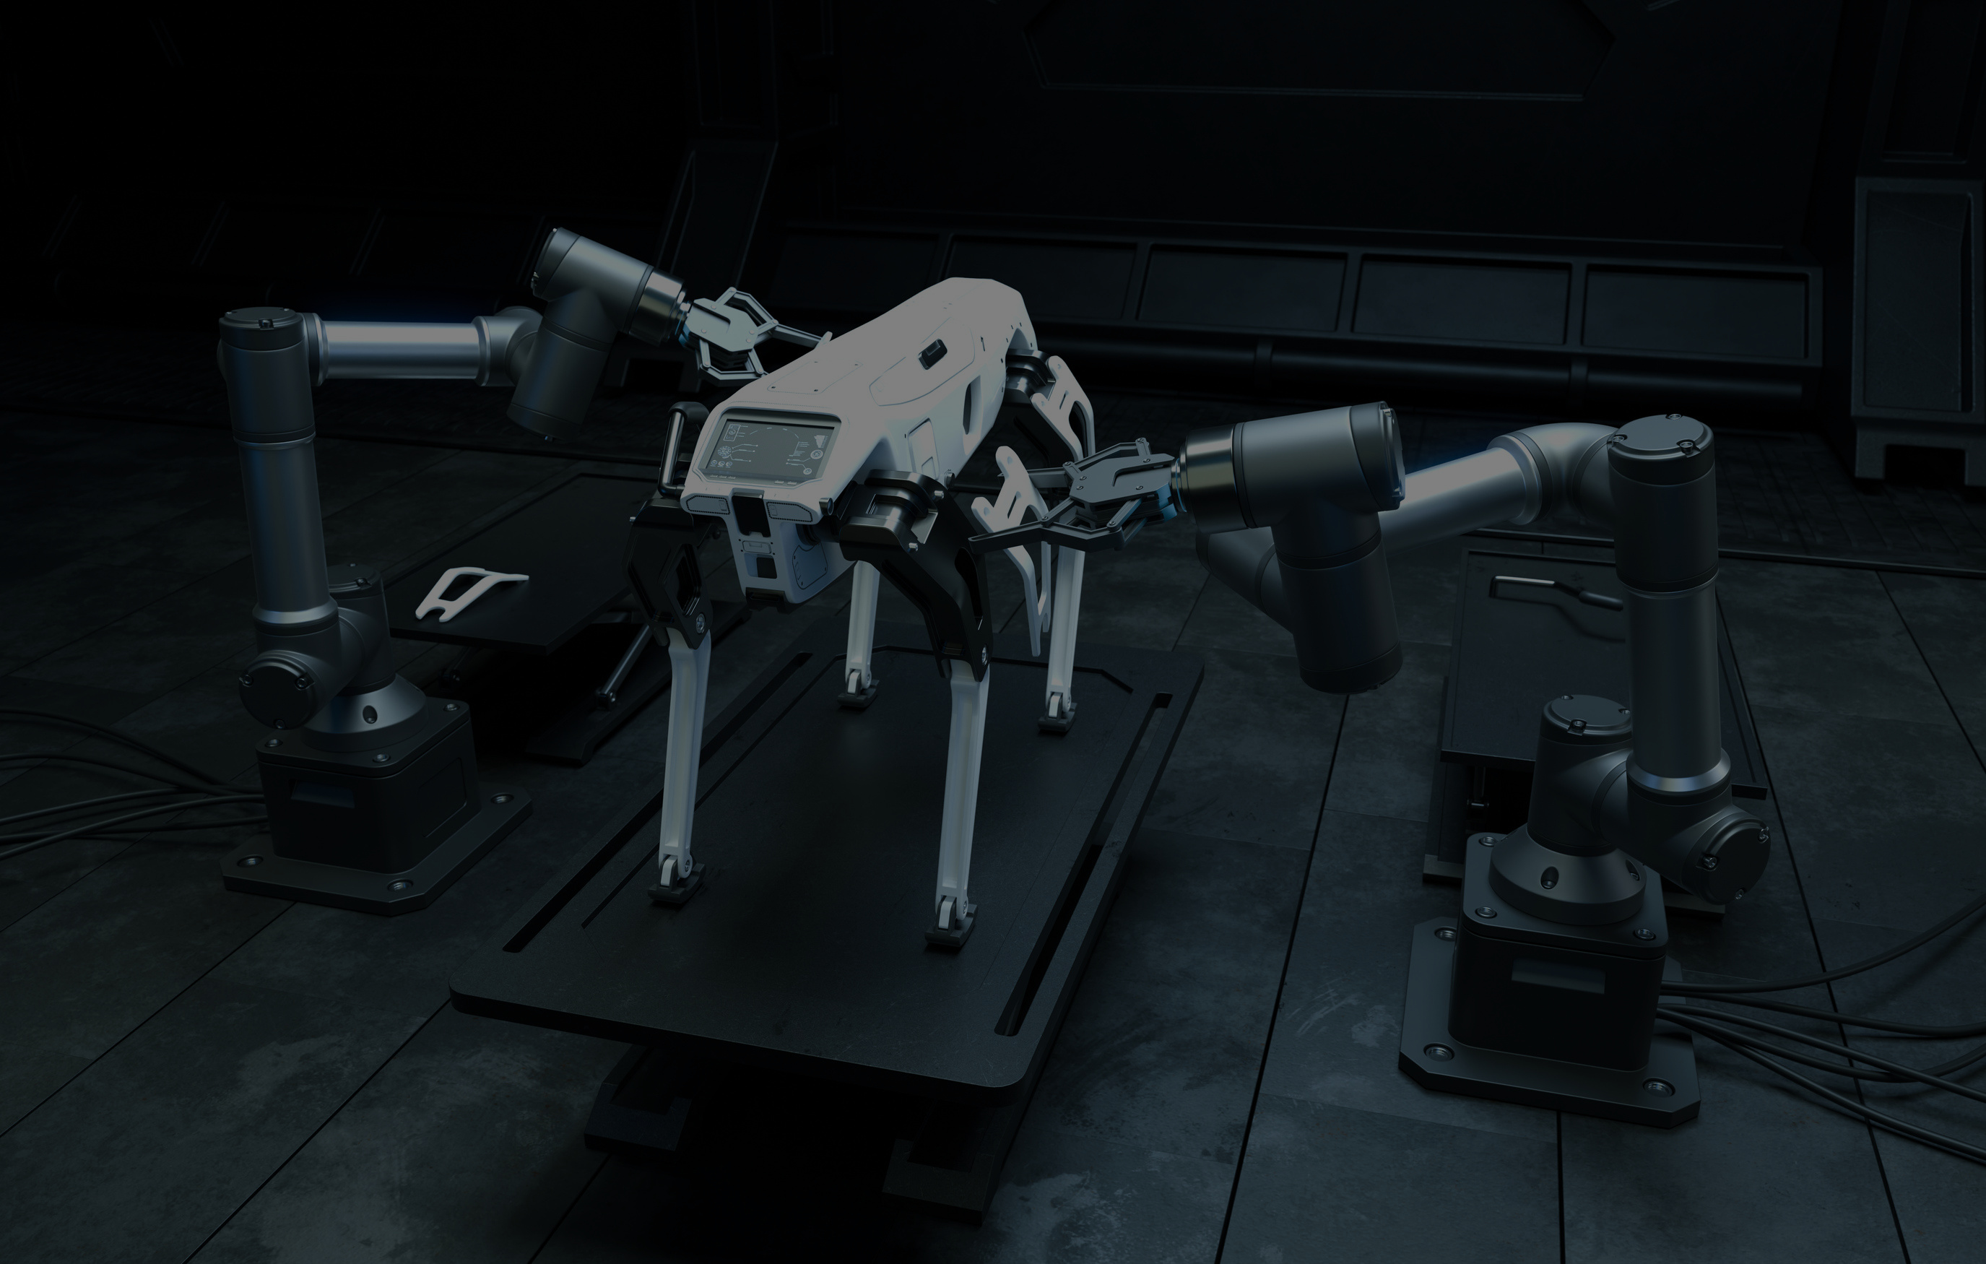


IPL ANALYSIS (2021-2023)
Using Power BI
next

Slide 2


OVERVIEW
02
Objective: Analyze IPL cricket data to gain insights into team and player performance, match outcomes, and key batting and bowling metrics.
Scope: Utilizing multiple related data tables to provide a comprehensive view of the tournament dynamics.
Tools Used: Power BI for data visualization and analysis.
next

Slide 3


VISUALS:
03
Project timeline or workflow diagram showing the stages from data collection to analysis and visualization.
A sample dashboard screenshot or preview of the analysis.
next

Slide 4


DATA SOURCES
04
Key Points:
Fact Bowling
Contains detailed data on bowling performance, such as match details, bowler statistics, and specific performance metrics like wickets and economy rate.
Fact Batting Summary
Captures batting performance with details like runs scored, batting position, and strike rate.
Dim Player
Provides player-specific information including team affiliation, batting and bowling styles, and playing role.
Dim Match Summary
Summarizes match results including teams, winner, victory margin, and match date.
Visuals:
A relational diagram showing how the data tables (Fact Bowling, Fact Batting, Dim Player, Dim Match Summary) are connected.
Sample data rows or key column highlights.
next

Slide 5


ANALYSIS FOCUS AREAS
05
Team Performance: Analyzing wins, losses, and performance trends across different seasons.
Player Performance: Deep dive into individual player metrics such as highest run-scorer, best bowler, strike rates, and economy rates.
Match Outcomes: Examining factors that influence match results, such as winning margins, crucial overs, and standout performances.
Batting vs Bowling Dynamics: Comparing team and player performances across different innings and match conditions.
next

Slide 6

VISUALS
06
Example visualizations such as bar charts for top performers, line charts for team performance trends, or pie charts for match outcomes.
A snippet of a dashboard showcasing key insights like top batsmen and bowlers.
next

Slide 7


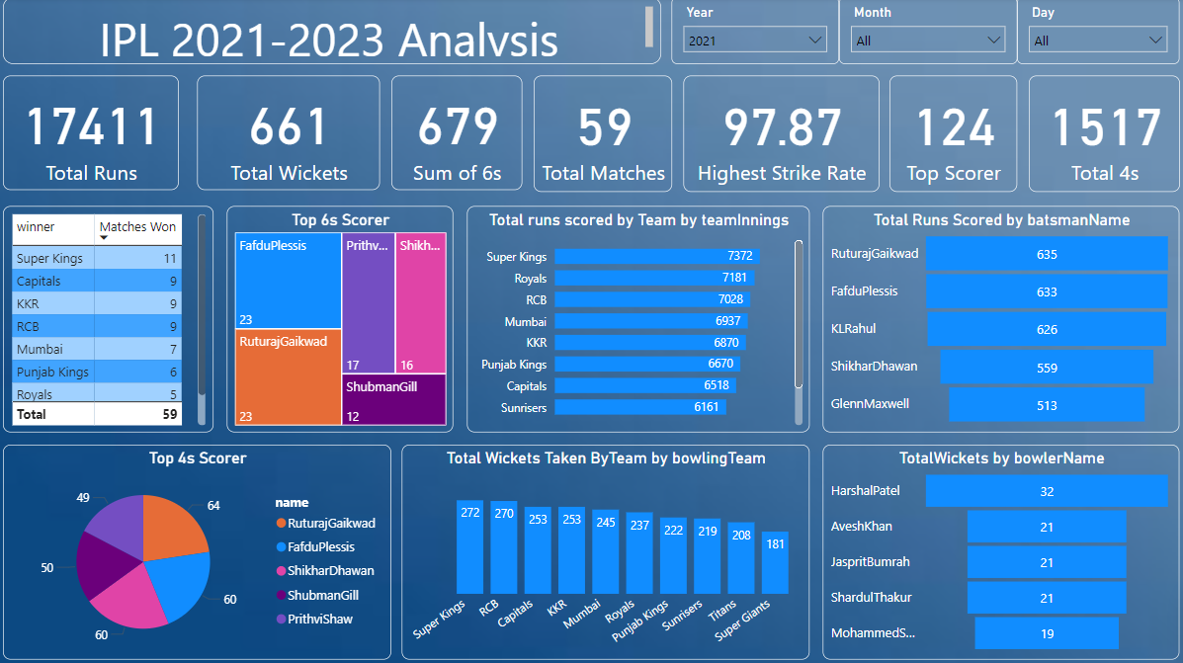
BI DASHBOARD
07
next

Slide 8

08
THANK YOU!

